Slide 1
Sentiment Analysis of Stocks from Twitter and News
Nikhil Valse
Department of Business, Long Island University
Gurpreet Singh
25th April 2023

Slide 2
Introduction
This project aims to perform sentiment analysis of stocks using news and Twitter data. The objective is to analyze the sentiment of news articles and tweets related to a particular company or industry and check the potential impact on the stock prices. The project will use machine learning techniques such as Natural Language Processing (NLP) and Machine Learning based sentiment analysis algorithms to analyze the textual data. Which can be used in the trading platforms to help traders make better decision
The project will use two sources of data for sentiment analysis: news articles and tweets and time series numerical data from Yfinance. News articles will be collected from various online news sources such as Finviz, and tweets will be collected from the multiple sources such as already dumped tweets on internet. The data will be pre-processed as required by the algorithm.

Slide 3
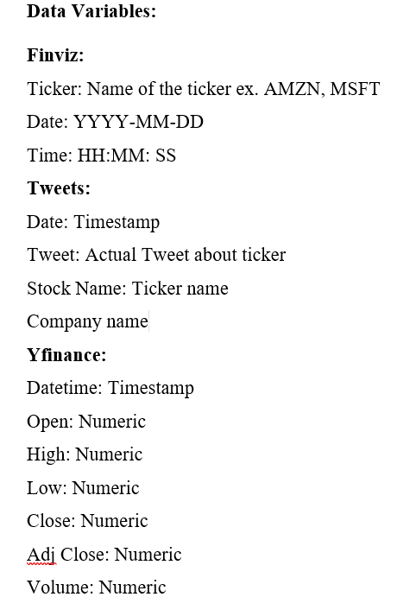
Data description

Slide 4
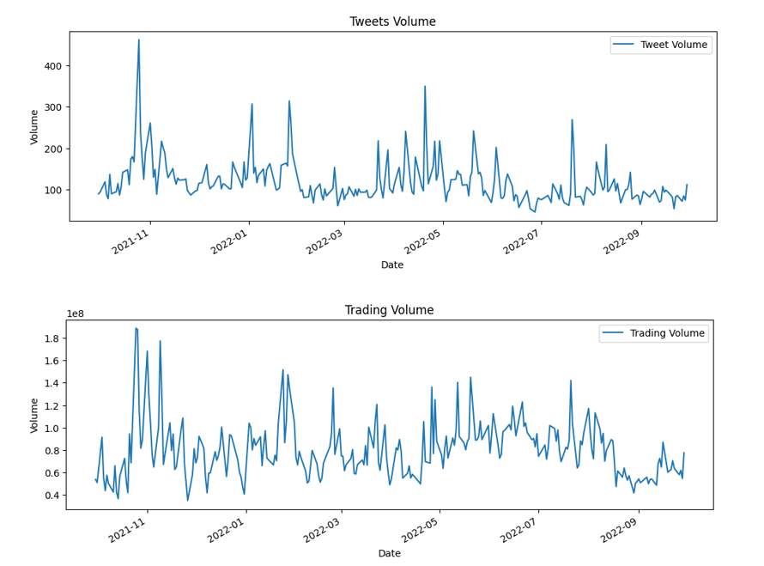

Comparison of trading volume and tweets made for TSLA
Corr. score

Slide 5
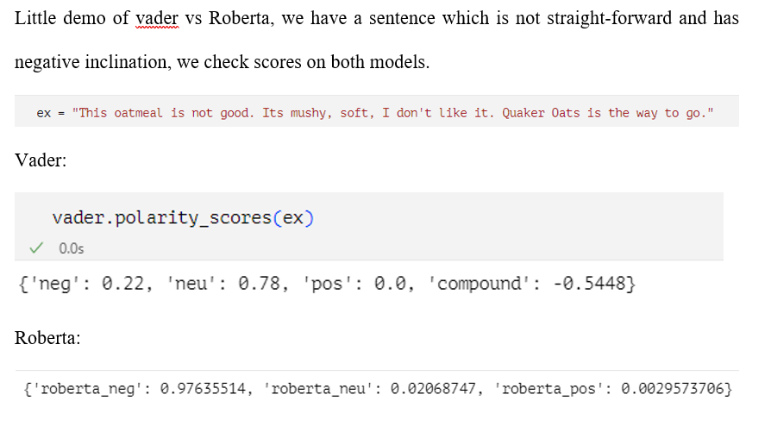
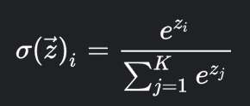
Comparison of models Rules-based vs ML based
Before softmax of Roberta-

Slide 6
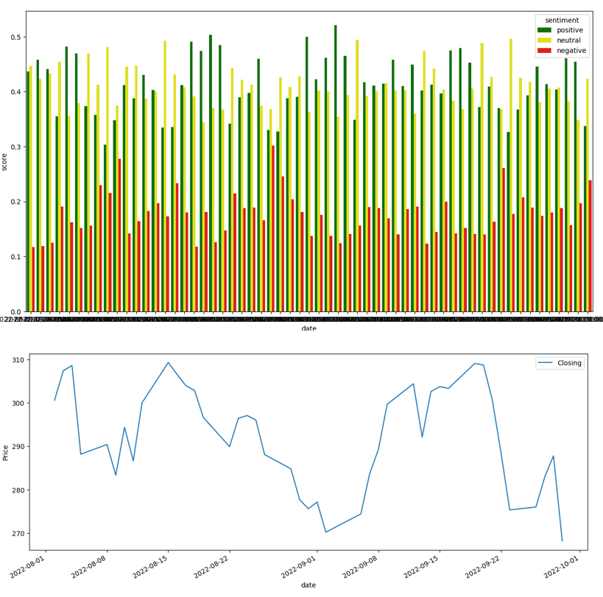
Comparison of the Roberta’s sentiment scores with closing value of the stock

Slide 7
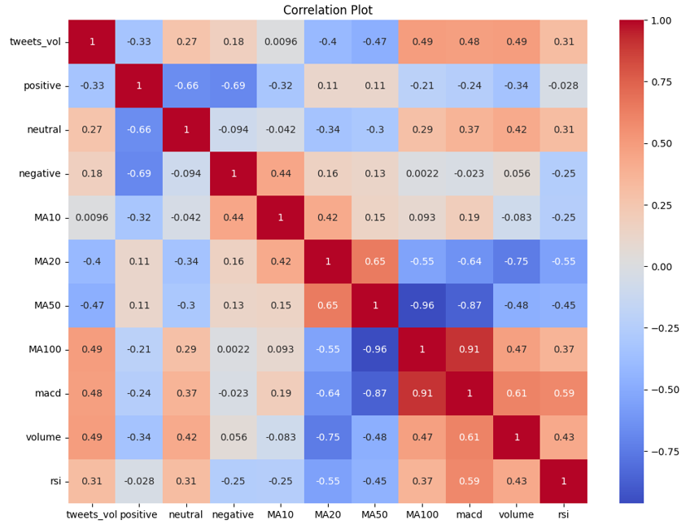
Correlation Plot of all numerical parameters in data frame

Slide 8
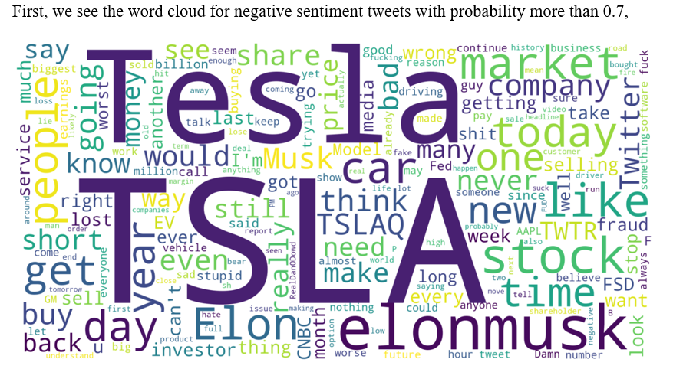
Word cloud of cleaned tweets of Tesla stocks

Slide 9
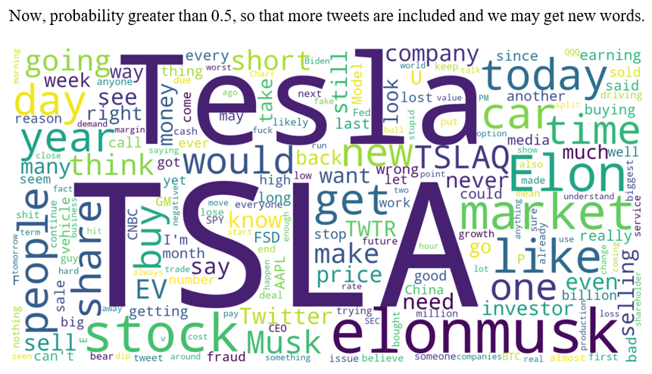

Slide 10
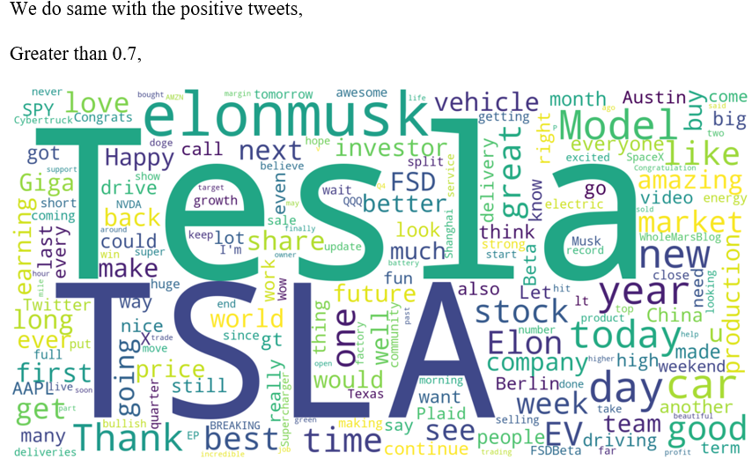

Slide 11
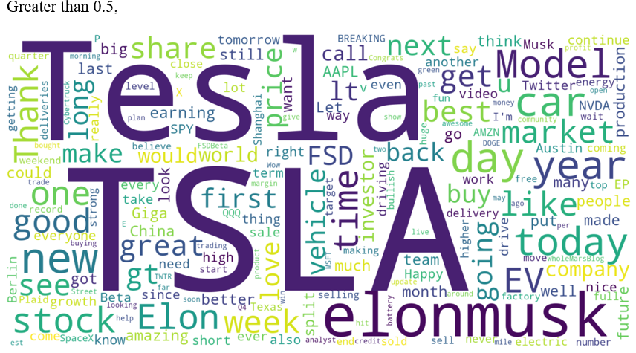

Slide 12
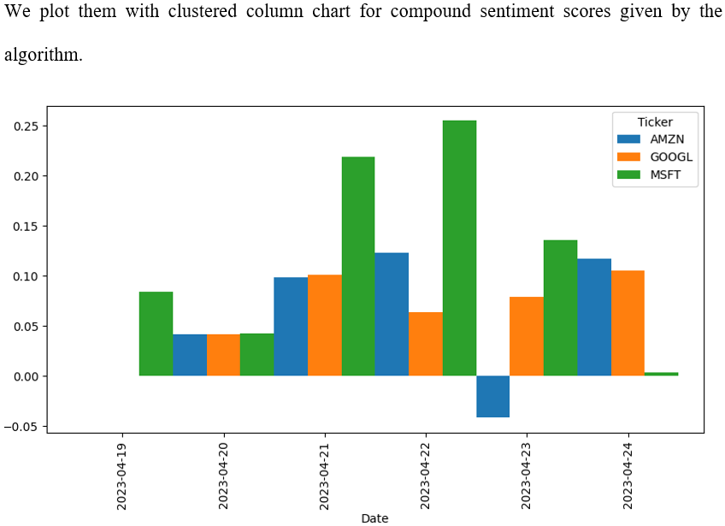

Slide 13
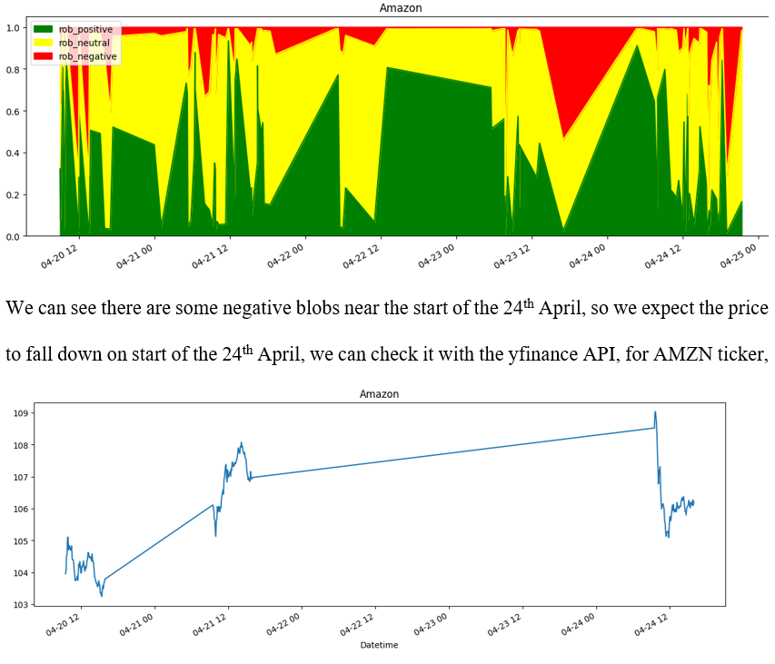

Slide 14
Thank You!

